Slide 1
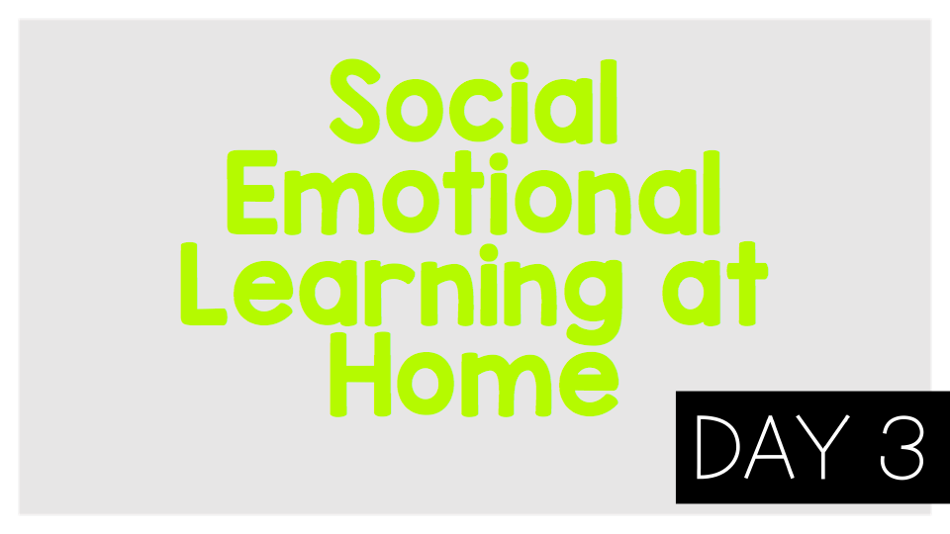
Emotions

Slide 2
Think:
Have you ever gotten so mad that you turned a small problem into a big problem?
Have you felt sad or embarrassed after having a big reaction to a small problem?
What does it mean to “flip your lid”?
How do our brains work to keep us safe?
What can you do if you’re about to “flip your lid”?

Slide 3
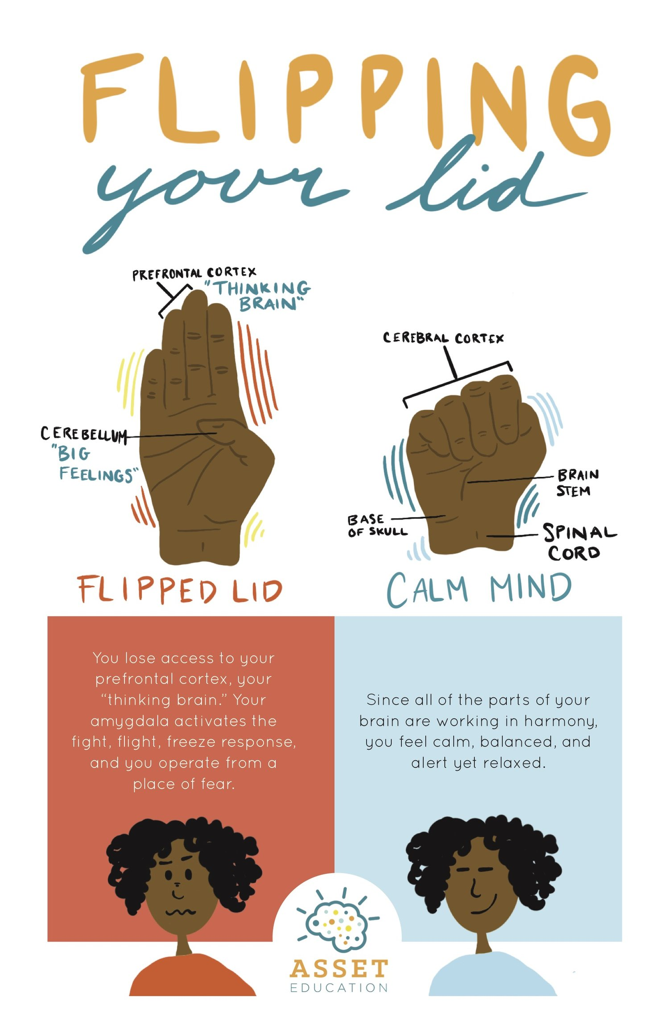
Activity:
Write about a time you “flipped your lid.” What happened? What could you have done differently to stay calm?

